Slide 1
AI Sales Coach
Team: Segfault after Midnight
Group: Cloover 5
Members
Simon Szulik, Mehdy Shinwari, Justin Weich, Valentina Varnakhina

Slide 2
Introducing David
your AI Sales Coach

Slide 3
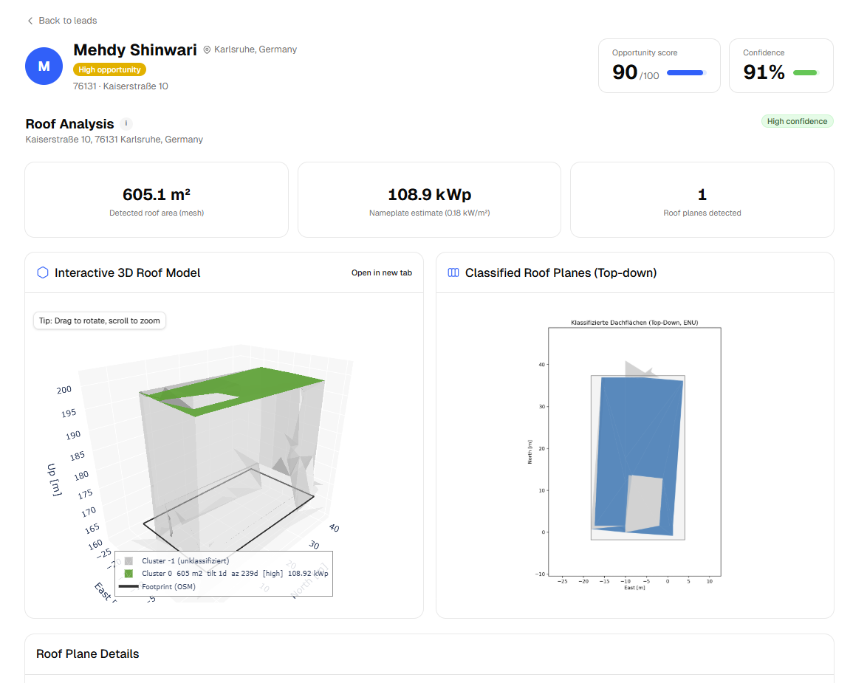

Slide 4
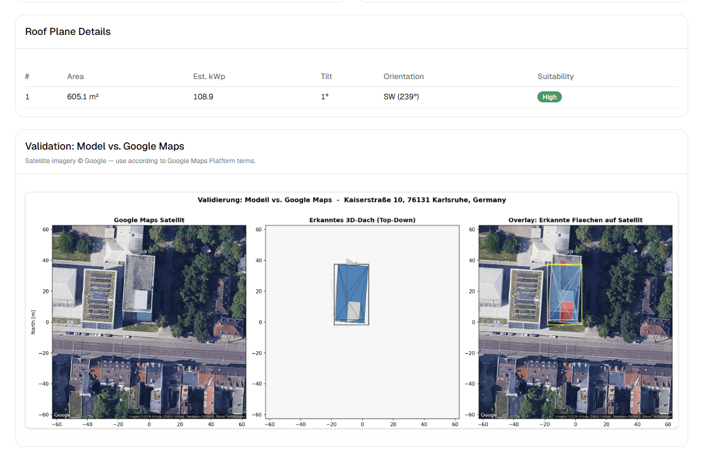

Slide 5
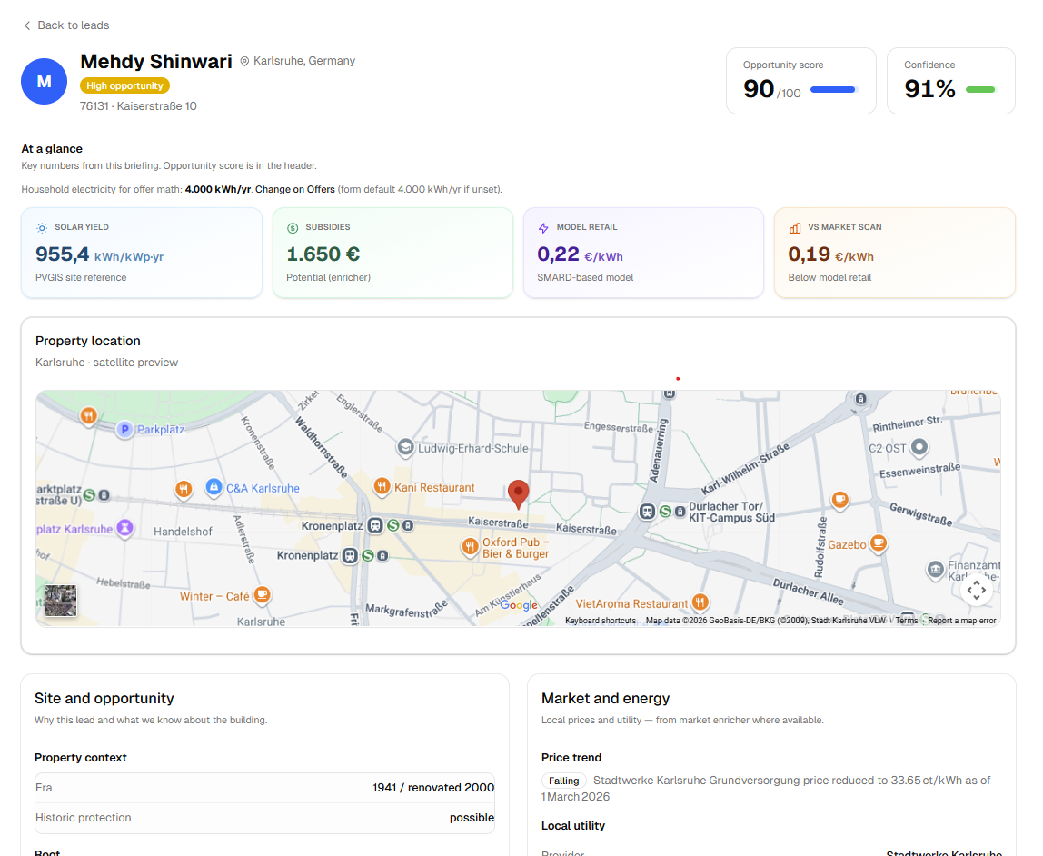

Slide 6
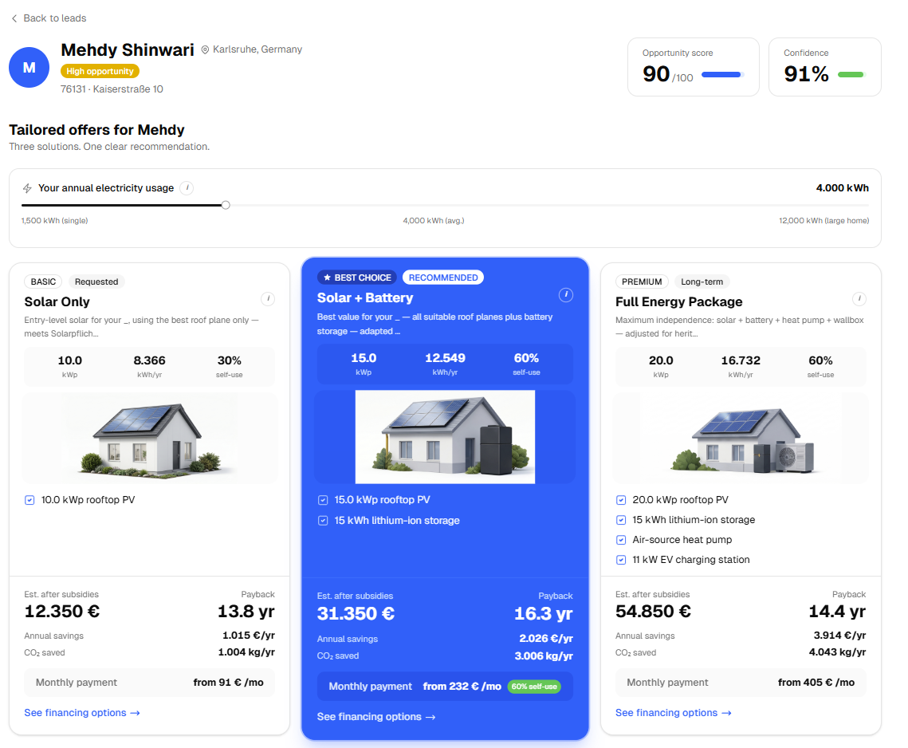

Slide 7
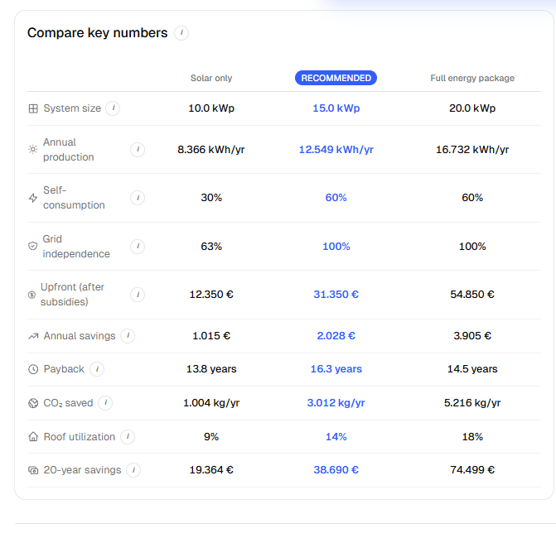

Slide 8
ARCHITECTURE
How a lead becomes a live pitch
INPUT Lead form — customer name + location
1
2
ENRICHMENT 7 parallel agents
Geocoding
Solar potential
Energy prices
Roof analysis
OSINT
Subsidies
Market context
PIPELINE Opportunity score + offer tiers + financing + coaching tips + roof analysis
3
OUTPUT Dashboard: Overview · Roof · Offers · Market · Pitch Assistant
4
CI / CD push → auto-pull → containers rebuild → live in prod

Slide 9
CHALLENGE VS. OUR BUILD
CHALLENGE PILLARS
WHAT WE BUILT
Market & regulatory context Energy price trends, carbon pricing, subsidies, regulations, why now
Compelling offer 2–3 personalised packages at different levels of ambition with justifications
Financing strategy Cash, partial financing, full financing scenarios with subsidies integrated
Sourcing via orchestrated agents 7 parallel agents: roof, solar, energy, subsidies, OSINT, market.
3 offer tiers + pitch assistant Good / Better / Best with cash, loan and lease scenarios and concrete advice for sales pitch
Financing scenarios Concrete financing scenarios integrated with locally available subsidies

Slide 10
WHERE WE GO NEXT
SCHUFA integration
Pull credit score to sharpen financing tiers and risk-adjusted pricing.
Deeper OSINT
Estimate income and obligations to tailor loan sizes and monthly rates.
Live adaptive offers
Rewrite offers on-the-fly as new info surfaces during the sales call.

Slide 11
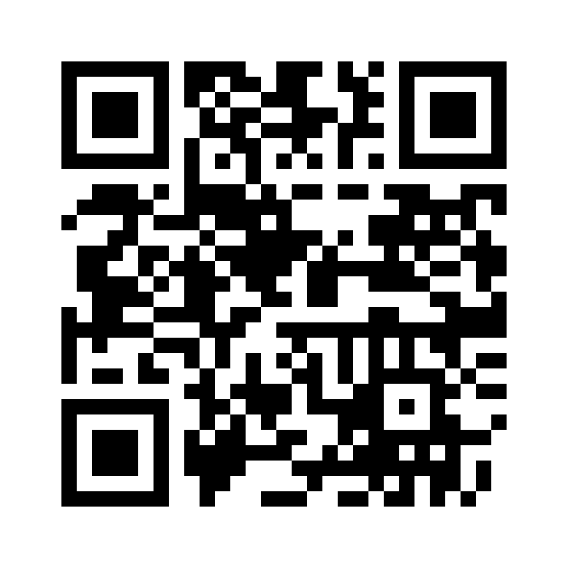
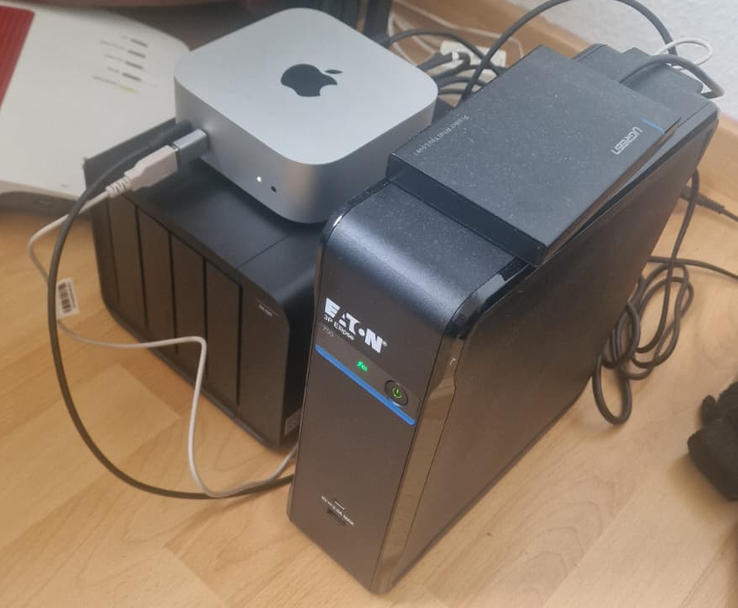
TRY David OUT NOW
LIVE AT
qhack.mehdy.eu
BUILT WITH
Next.js + FastAPI • Google Cloud APIs • Claude
Hosted with <3

Slide 12
THANK YOU
& questions
Segfault after Midnight
Cloover Q-Hack 2026 • Group 5
Live demo: qhack.mehdy.eu

